Slide 1
Rockbuster Stealth LLC Data Analysis Project.
May 2024, by Shruti Dubey.

Slide 2

01
Introduction

Slide 3
Introduction
Our company
Objective
Rockbuster Stealth LLC is a movie rental company that used to have stores around the world. Facing stiff competition from streaming services such as Netflix and Amazon Prime, the Rockbuster Stealth management team is planning to use its existing movie licenses to launch an online video rental service in order to stay competitive.
The Rockbuster Stealth Management Board has asked a series of business questions and they expect data-driven answers that they can use for their 2020 company strategy.

Slide 4
Questions
Which movies contributed the most/least to revenue gain?
What was the average rental duration for all videos?
Which countries are Rockbuster customers based in?
Where are customers with a high lifetime value based?
Do sales figures vary between geographic regions?

Slide 5
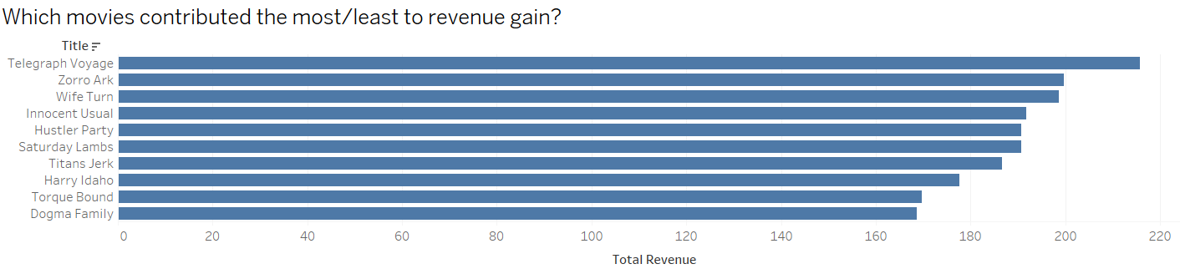
Which movies contributed the most /least to revenue gain?

Slide 6
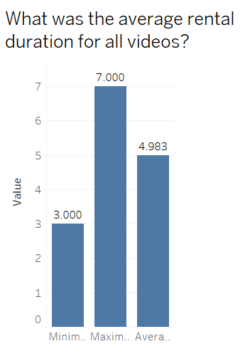
What was the average rental duration for all videos?

Slide 7
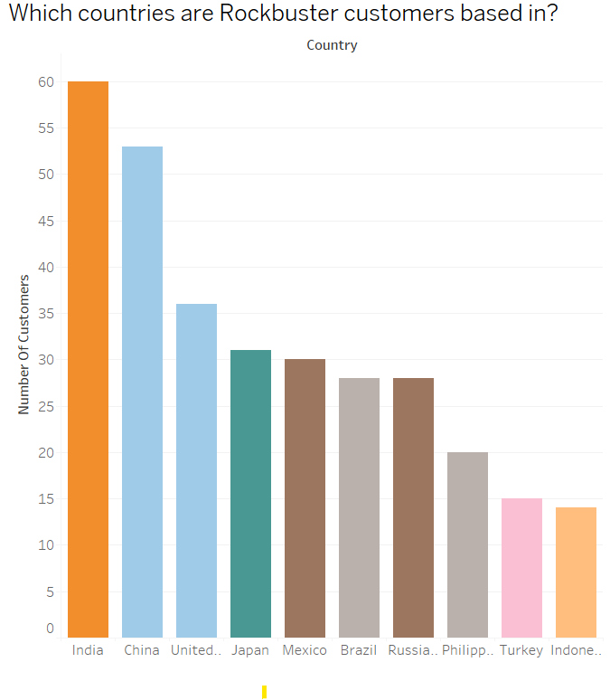
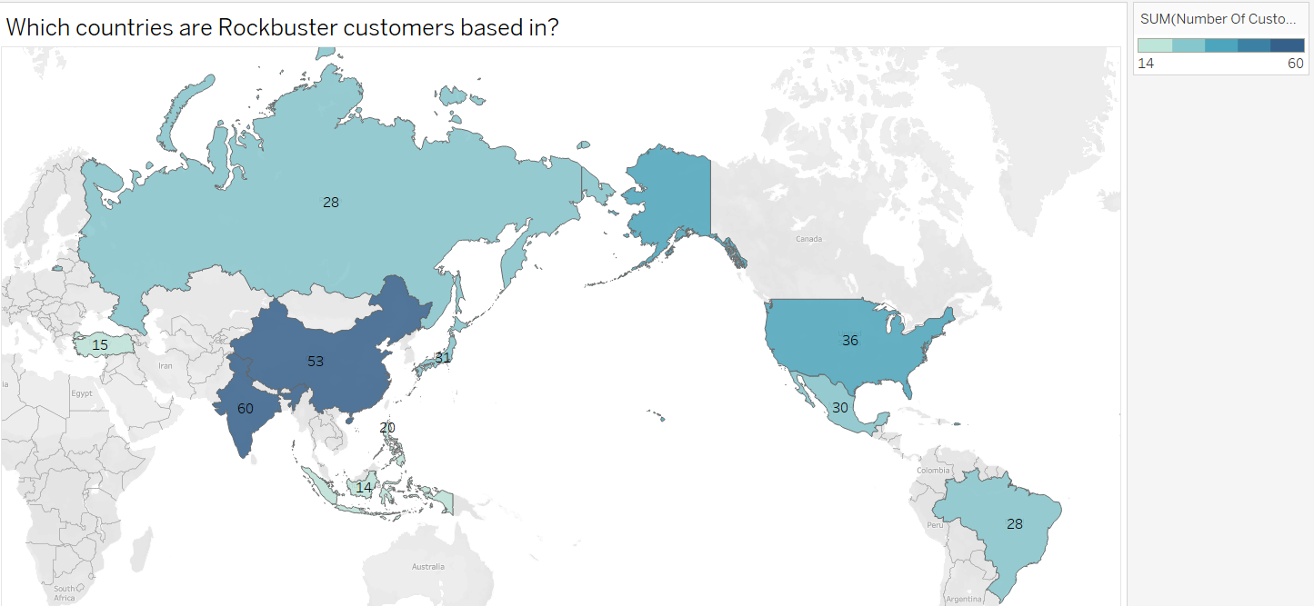
Which countries are Rockbuster customers based in?

Slide 8
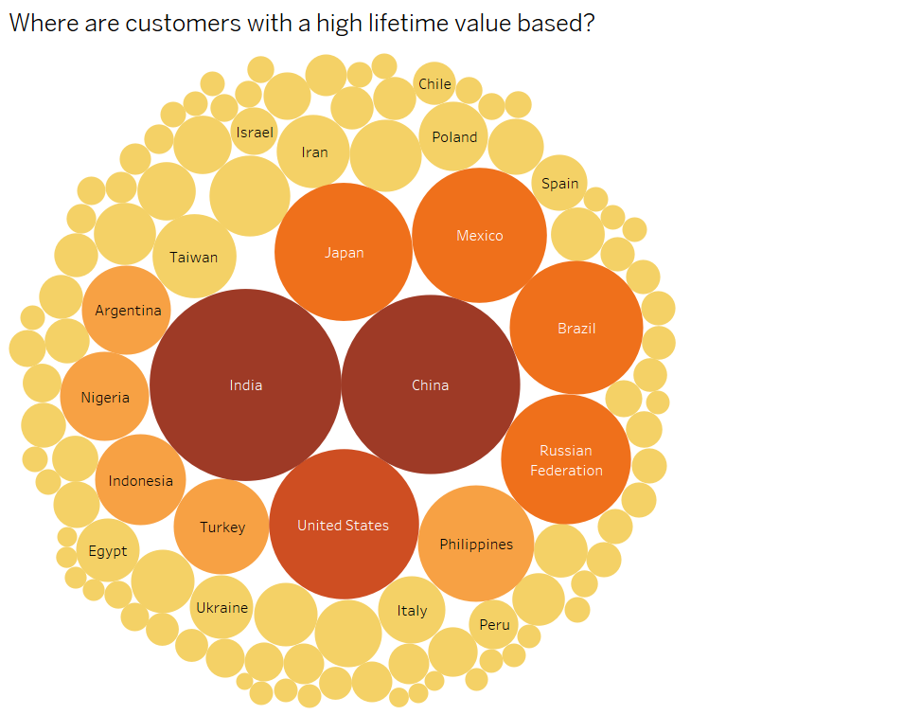
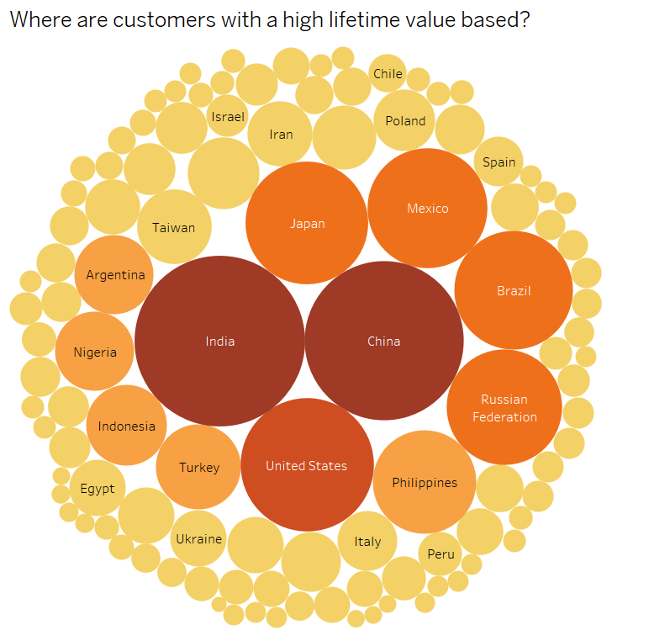
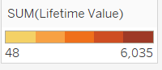
Where are customers with a high lifetime value based?
India – 6,035
China- 5,251
United States-3,685
Japan-3,123
Mexico-3,000
Brazil-2,919
Russian Federation-2,750
Philippines-2,220
Turkey- 1,498
Indonesia-1,410

Slide 9
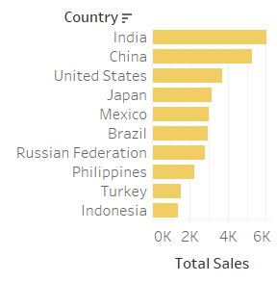
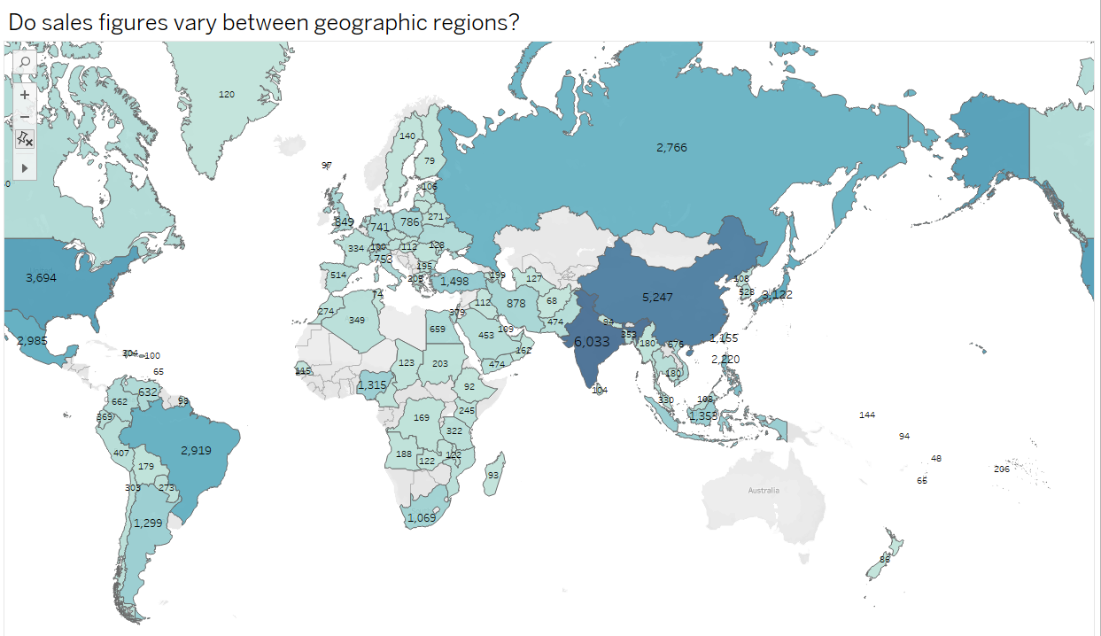
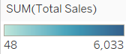
Do sales figures vary between geographical regions?

Slide 10
Conclusion
Most of our customers come from countries where English is not the primary language. This means we need to adjust our content and strategies to better fit their cultural backgrounds.
Our collection mainly consists of English-language films from 2006 onwards, which might limit our appeal to a wider audience. On average, customers rent movies for about five days. Offering more flexibility in our rental options could improve overall customer satisfaction and engagement.
Some specific countries contribute the most to our revenue, so we should focus our marketing efforts on those regions and tailor them to the preferences of their populations.

Slide 11
Thanks!
Do you have any questions?
shrutidubey045@gmail.com

